Slide 1


is it phishing?
By: Batoul Alosaimi
Norah Alqahtani
Shroaq Almutiri

Slide 2
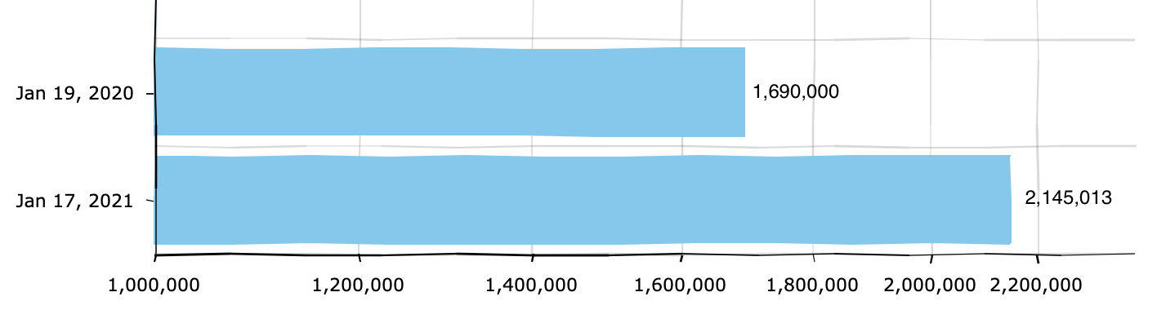
INTRODACTION AND SOME STATISTICE
According to Google Safe Browsing; Google has registered 2,145,013 phishing sites as of Jan 17, 2021. This is up from 1,690,000 on Jan 19, 2020 (up 27% over 12 months).
Notes:
According to Google Safe Browsing; Google has registered 2,145,013 phishing sites as of Jan 17, 2021. This is up from 1,690,000 on Jan 19, 2020 (up 27% over 12 months).
According to recent research from Proofpoint 75% of organizations around the world experienced a phishing attack in 2020, and 74% of attacks targeting US businesses were successful
IBM found that customers’ personally identifiable information (PII) was both the most commonly compromised type of data and the costliest.

Slide 3
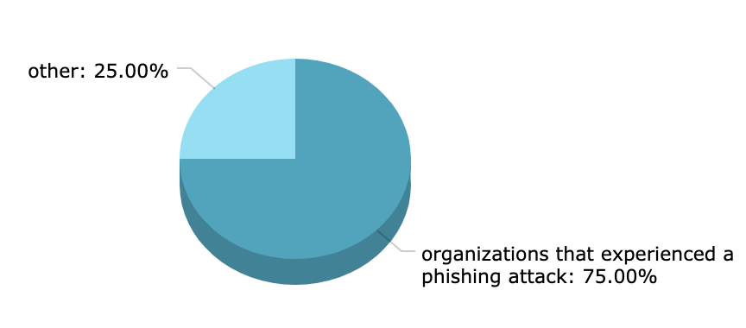
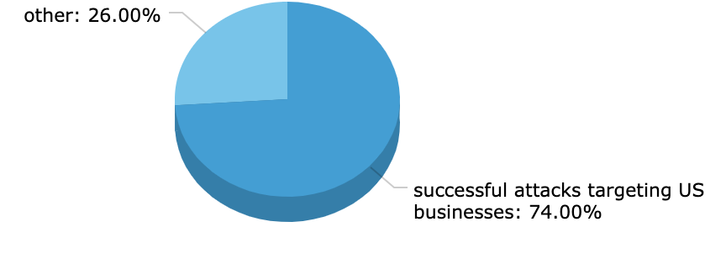
INTRODACTION AND SOME STATISTICE
Notes:
According to Google Safe Browsing; Google has registered 2,145,013 phishing sites as of Jan 17, 2021. This is up from 1,690,000 on Jan 19, 2020 (up 27% over 12 months).
According to recent research from Proofpoint 75% of organizations around the world experienced a phishing attack in 2020, and 74% of attacks targeting US businesses were successful
IBM found that customers’ personally identifiable information (PII) was both the most commonly compromised type of data and the costliest.

Slide 4
INTRODACTION AND SOME STATISTICE
IBM found that customers’ personally identifiable information (PII) was both the most commonly compromised type of data and the costliest.
Notes:
According to Google Safe Browsing; Google has registered 2,145,013 phishing sites as of Jan 17, 2021. This is up from 1,690,000 on Jan 19, 2020 (up 27% over 12 months).
According to recent research from Proofpoint 75% of organizations around the world experienced a phishing attack in 2020, and 74% of attacks targeting US businesses were successful
IBM found that customers’ personally identifiable information (PII) was both the most commonly compromised type of data and the costliest.

Slide 5
METHODOLOGY
Understand The problem
Data preprocessing
Classification models
Gathering Data
Exploratory Data analysis
Evaluating

Slide 6
DATA SET
- Public source from Declaration on Scientific paper named ‘Phishing URL Classification using Machine Learning’
- Size
- Target
10000 records
15 columns
1 : Phishing
0 : Benign

Slide 7
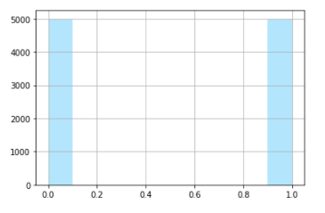
EXAPLORTY DATA ANALYISI
Target :
0 is benign
1 is Phishing

Slide 8
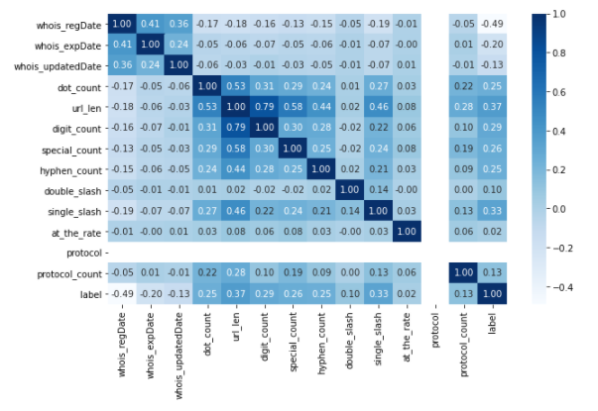
EXAPLORTY DATA ANALYISI
correlation between the Target and features, and between each features

Slide 9
Data Preparation
Data Cleaning : - Find and drop null values. - Find duplicated. Feature Engineering : - we can see that 'protocol' column has no values but 0 in it so we will drop it. - The scale of at_the_rate column is deferent than the other columns.

Slide 10
Splitting the data
40%
TEST
VALIDATION
48%
12%
TRAIN

Slide 11
MODELLING
Models
K-Nearest Neighbors
Logistic Regression
Decision Tree
Random Forest
SVM
XGBoost
Naive Bayes

Slide 12
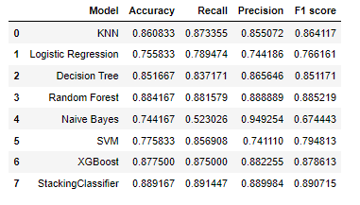
EVALUATING
Table showing all confusion matrix values of the models.

Slide 13
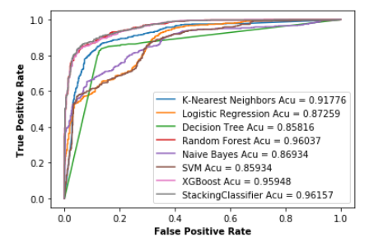
ROC CURVE

Slide 14
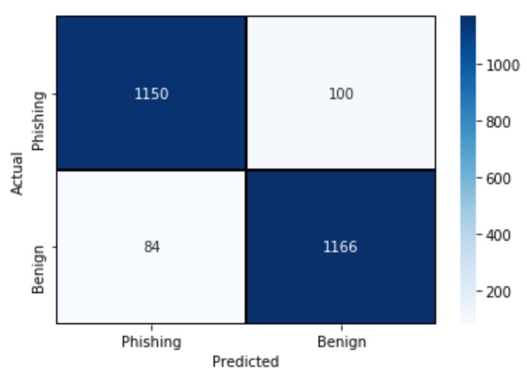
Best model for our project (Random Forest)
RF Accuracy= 0.93
RF F1 score= 0.93

Slide 15
Flask API
Save the Model
Create fanction which take URL and extract its features
Buils website using Flask API
http://127.0.0.1:5000/

Slide 16
FUTUER WORK
Conclusion
Our model solve the problem of classifing URLs with accuricy(0.93) and F1(0.93)
By comparing our results with the results of the previous work; our accuracy is better where theirs is 0.87
Publish a website
Improving the Model until F1= 0.96
Create ourown Dataset

Slide 17
THANKS!

